Slide 1
Global crude oil peak started 2005
Matt Mushalik
mushalik@tpg.com.au
@crudeoilpeak
www.crudeoilpeak.info
Notes:
http://3.bp.blogspot.com/-NxouMmz2bOY/T8_ac97cesI/AAAAAAAAGg0/e3vY1_bdnbE/s1600/Twitter+logo+2012.png

Slide 2
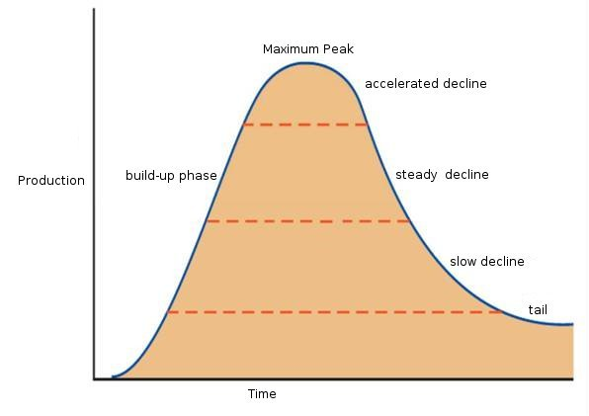
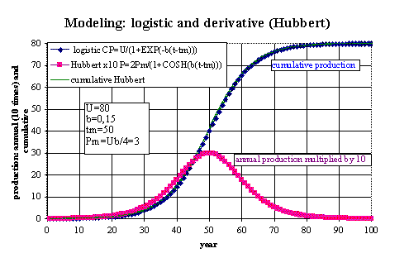
HUBBERT CURVE
Production
Time
P = 2Pm/(l+COSH(-b(t-tm)))
Classical definition of peak oil:
maximum oil production in time series
Notes:
http://www.oilcrisis.com/laherrere/multihub.htm
The equation for the Hubbert curve for the annual production P (being delta CP/delta t) is simple when related to peak annual production Pm occurring at year tm:
P = 2Pm/(l+COSH(-b(t-tm)))

Slide 3
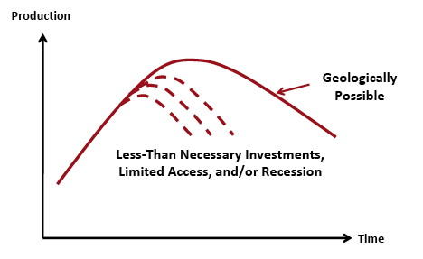
PEAKING AS PROCESS
Reality:
peak oil is a complex process,
not an event limited to the year of global maximum production
Notes:
http://www.phaster.com/_peak/basic_peak_oil_primer.html

Slide 4
PEAKING IN DIFFERENT AREAS
In fields: (North Sea offshore)
Shale oil (Bakken)
Country level (UK)
Region (Middle East, South East Asia)
World Peak
Notes:
http://www.phaster.com/_peak/basic_peak_oil_primer.html

Slide 5
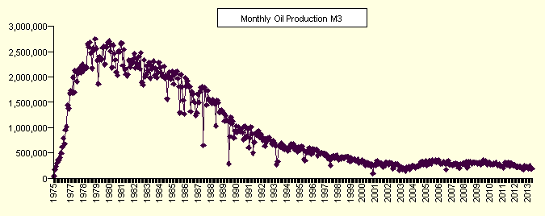
North Sea offshore
Field: Forties

Slide 6
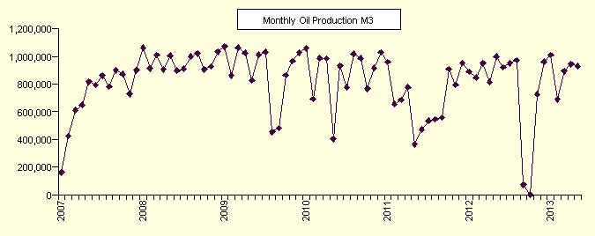
North Sea offshore
Field: Buzzard
https://www.og.decc.gov.uk/pprs/full_production.htm

Slide 7
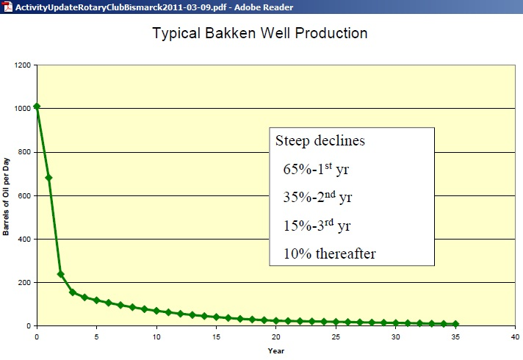
shale oil (tight oil)

Slide 8
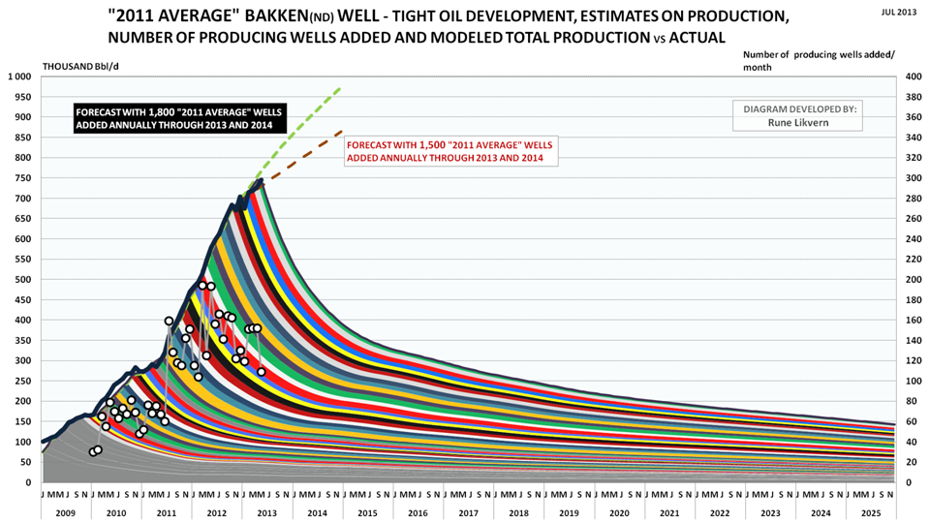
shale oil (tight oil)
Notes:
Will the Bakken “Red Queen” Have to Run Faster?
Further growth is function of number of drilling rigs and well productivity. Once most “sweet spots” have been drilled, growth will slow and there will be a peak because new wells may no longer fully offset decline in older wells.
http://www.theoildrum.com/node/10102

Slide 9
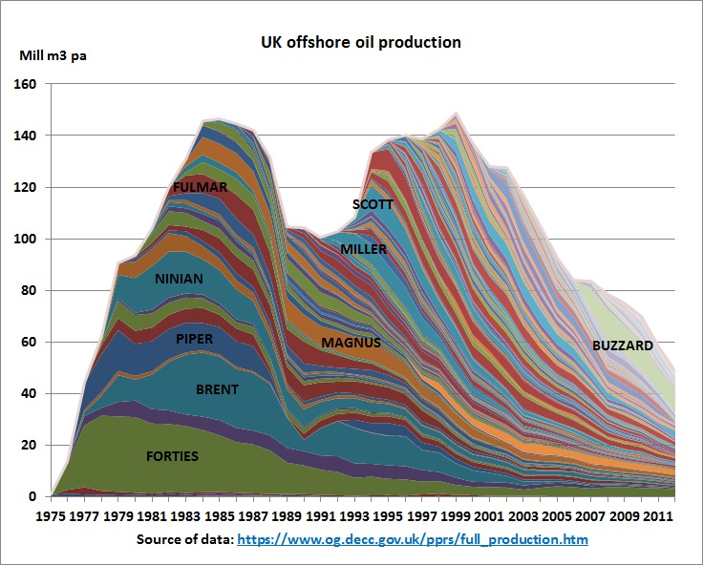
Peak oil at country level
Notes:
Big fields are developed first. July 1988: Alpha Piper accident http://en.wikipedia.org/wiki/Piper_Alpha caused the dip BUT the 1st peak had already happened BEFORE the accident. Peaking of Brent, Piper, Ninian came earlier than expected. 2nd peak from many small fields. Buzzard a small hump on declining curve

Slide 10
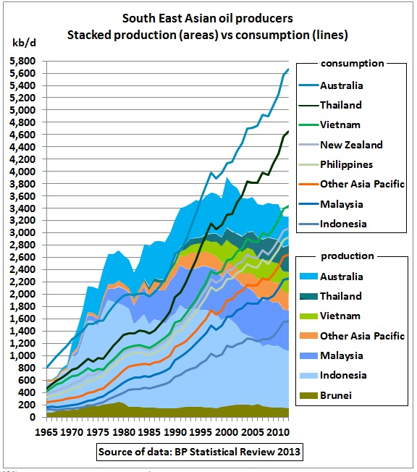
Peak oil in region
Notes:
Consider this graph when there is talk about the Asian Century which totally dependent on the Middle East

Slide 11
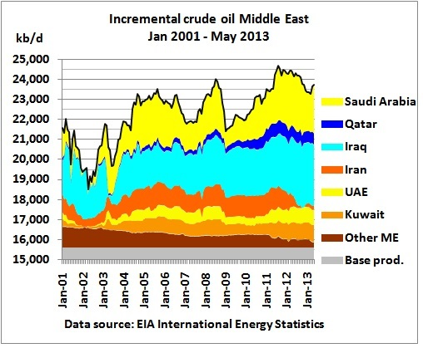
Middle East

Slide 12
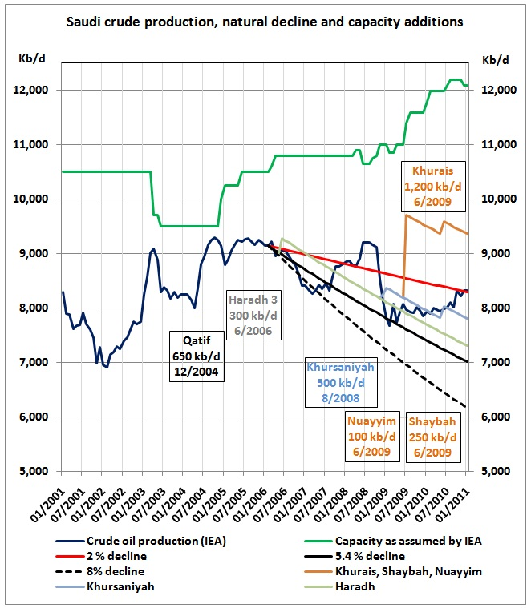
Saudi Arabia
Notes:
http://crudeoilpeak.info/wikileaks-cable-from-riyadh-implied-saudis-could-pump-only-9-8-mbd-in-2011
Saudi Arabia’s production decline 2006/07 caused high oil prices and recession in the US. Supply boost to cover Chinese demand for Olympic Games in 2008. Collapse of Lehman Brothers and resulting GFC was triggered by convergence of high oil prices and accumulated debt crisis

Slide 13
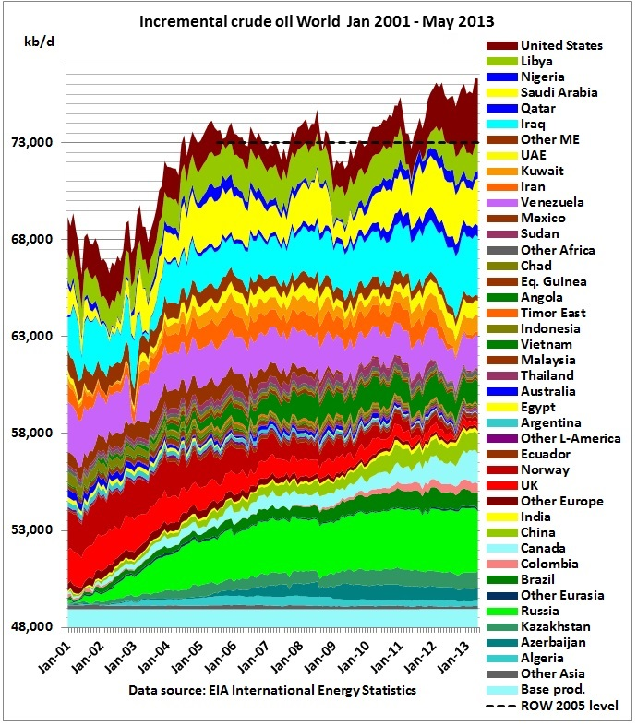
INCREMENTAL CRUDE OIL Peak - WORLD
Notes:
Peak oil in world is superimposition of many country peaks
Base production: sum of minimum production in period Jan 2001 – May 2013
US shale oil hides crude oil peak in rest of world http://crudeoilpeak.info/us-shale-oil-hides-crude-oil-peak-in-rest-of-world

Slide 14
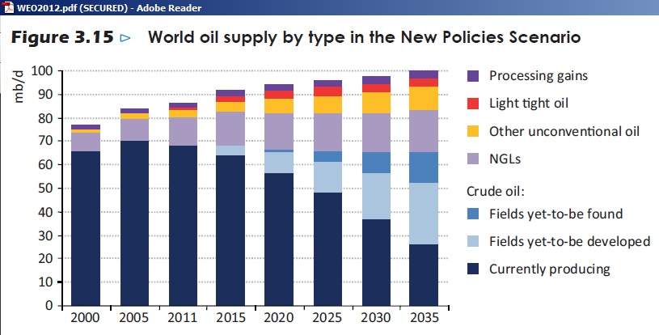
WEO 2012 from IEA
Notes:
IEA is forced by member countries to show growth. On the other hand, the graph shows a clear warning that currently producing fields peaked in 2006 and that it will be difficult to offset this decline with new fields. So NGLs and unconventional oil are added.

Slide 15
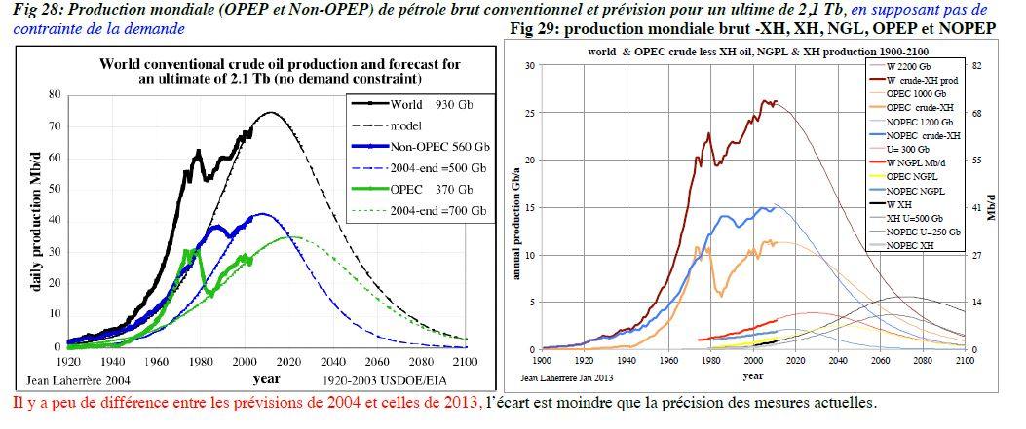
Laherrere (2004/2013)
Notes:
Comparison 2004/2013 estimates
From Laherrere
http://aspofrance.viabloga.com/files/JL_Marseilles-english.pdf
http://cassandralegacy.blogspot.it/2013/08/who-said-that-peak-oil-models-were-wrong.html

Slide 16
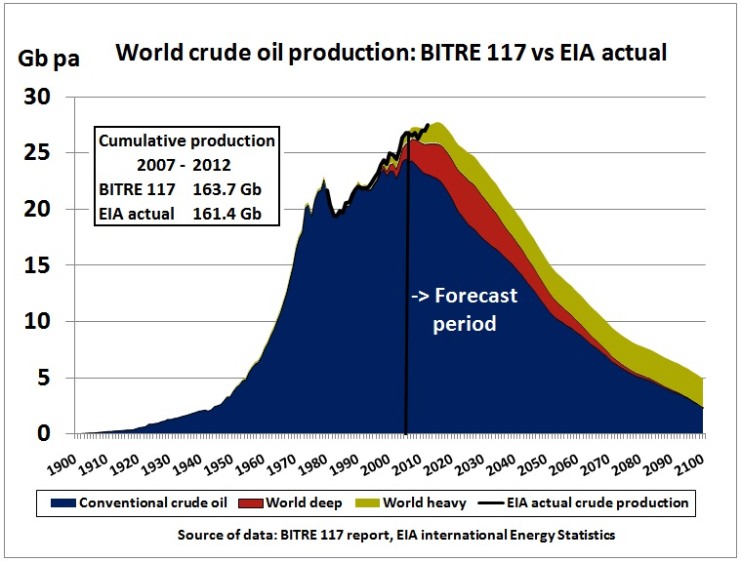
BITRE 117 and EIA Actual
Notes:
Peaky leaks BITRE 117
The federal government (under Resource Minister Martin Ferguson) completed a peak oil report in February 2009, but neither published nor updated it in the 2011 Energy White paper. A French blogger got hold of it and put it on his website in 2011. In January 2012, the story made it to the Daily Telegraph, an unlikely candidate to take up this topic. In a February 2012 Senate hearing the Greens asked the government to table the report but Industry Minister refused arguing the report was not “up to scratch”.

Slide 17
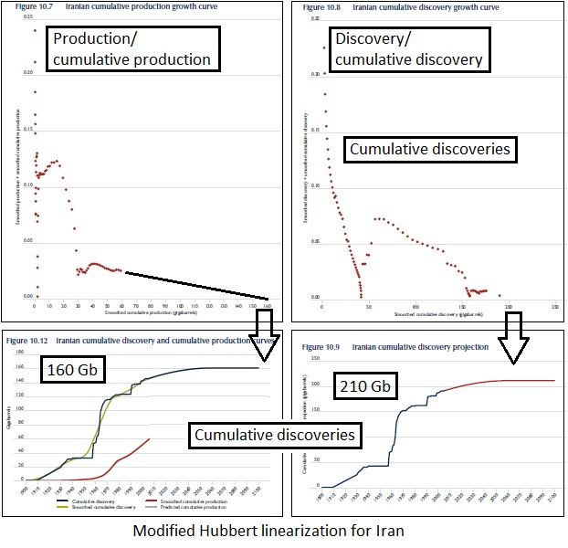
BITRE 117 - methodology 1
Notes:
BITRE 117 used following methodology for each country:
Plot smoothed historic production/cumulative production and draw trend line to get ultimate cumulative production (UP)
Plot smoothed cumulative discovery curve and guestimate ultimate discovery (UD)
Adjust cumulative discovery curve to more reliable UP

Slide 18
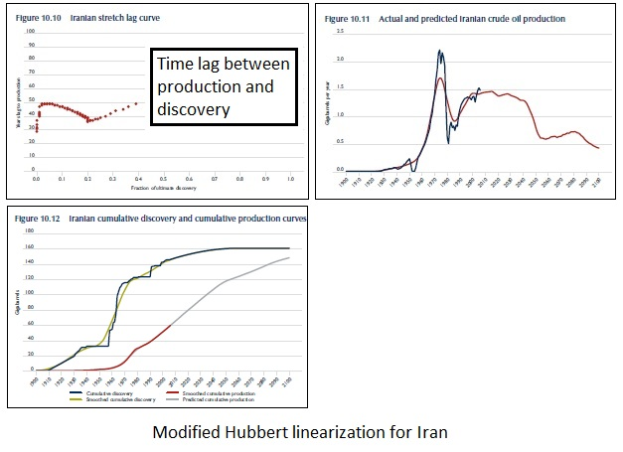
BITRE 117 - methodology 2
Notes:
Calculate the lag between historic cumulative discovery and production in years. Extrapolate trend into future
Draw future production curve on the basis of the cumulative discovery curve and the time lag between production and discovery

Slide 19
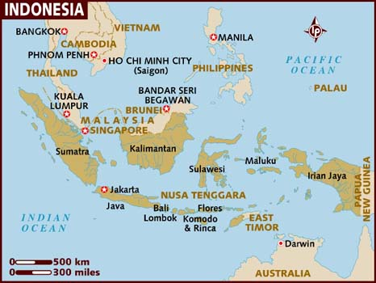
PEAKS with geopolitical implications
Iran
Egypt
Syria
Sudan
Libya
Yemen
Indonesia
Notes:
Peaks in countries with geopolitical implications

Slide 20
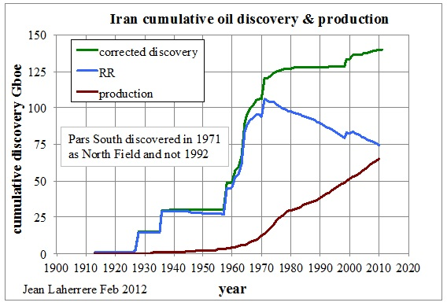
IraN
Notes:
In the BP Statistical Review, Iran’s “proven reserves” for 2010 are 151 Gb. But French oil-geologist shows that these are discoveries (green curve), not remaining reserves which are in decline (blue curve). Cumulative production (red curve) will soon hit the reserve curve which is the depletion midpoint.

Slide 21
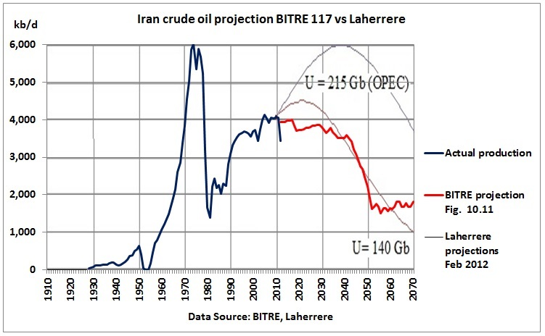
BITRE 117 vs LAHERRERE
Notes:
Comparison of projections between BITRE 117 (160 Gb) and Laherrere

Slide 22
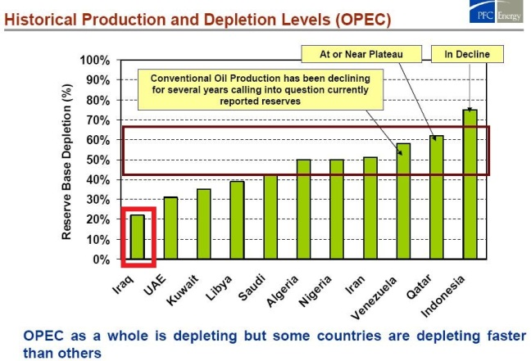
OPEC Production & Depletion
Notes:
Wild-card Iraq
Graph by PFC Energy presented to the Centre for Strategic and International Studies (Washington) in 2004, one year after the Iraq war. Iraq underproduced oil during the Iran-Iraq war and then under UN sanctions (oil for food program)

Slide 23
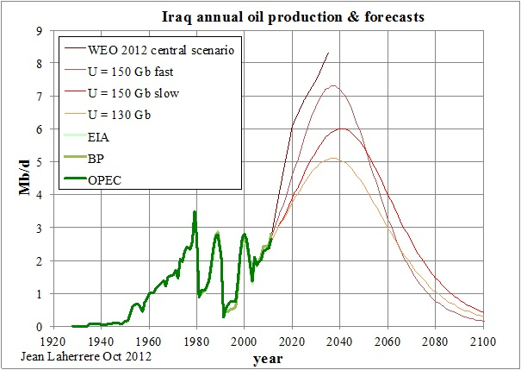
Iraq - OIL PRODUCTION & FORECASTS
Notes:
Theoretical, Hubbert-type oil production curves from Jean Laherrere based on different scenarios. Saudi Arabia, Kuwait and UEA are unlikely to allow this to happen. There will be fights in OPEC about Iraq’s quotas

Slide 24
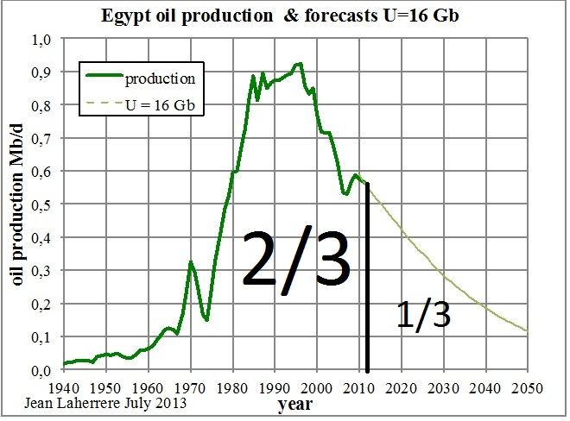
Egypt – GEOPOLITICAL IMPLICATIONS
Notes:
Peak oil in countries with geopolitical implications
20 years after the peak, 2/3 of the ultimate has been produced

Slide 25
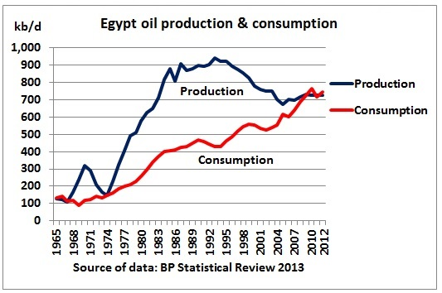
Egypt – Production & Consumption
Notes:
Egypt is now a net oil importer. Uptick in production is result of enhanced oil recovery and involvement of international oil companies. But Egypt has to pay international oil prices for its own oil in production sharing contracts.

Slide 26
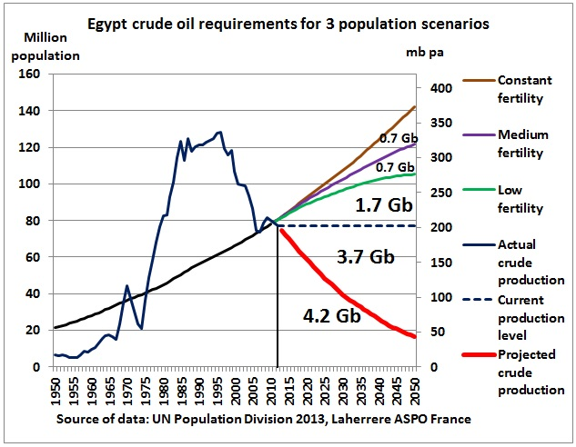
Egypt – Population SCENARIOS
Notes:
Increasing import requirements will depend on oil decline and population growth. This oil will have to come from neighbouring countries like Saudi Arabia, Kuwait and UAE, at a discount. World markets will not see this oil. Example: during the height of the crisis earlier this year, a tanker in the Suez canal was diverted to an Egyptian refinery.

Slide 27
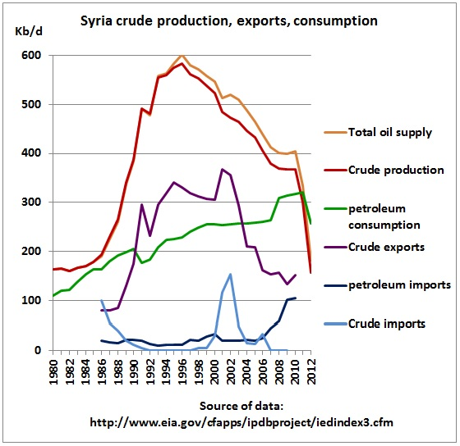
Syria
Notes:
When oil production peaks, exports fall and imports rise. That puts pressure on budgets with negative impacts on the economy. Dictatorships are in trouble.

Slide 28
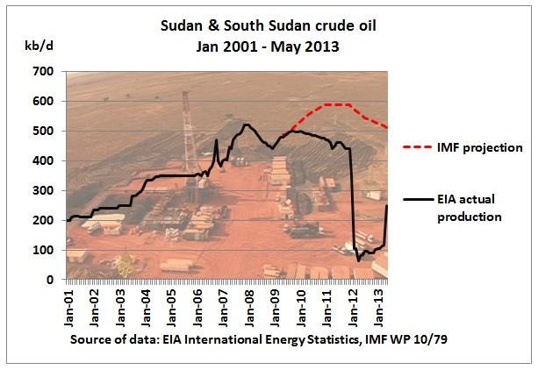
Sudan
Notes:
Example where peak oil is connected with territorial issues.

Slide 29
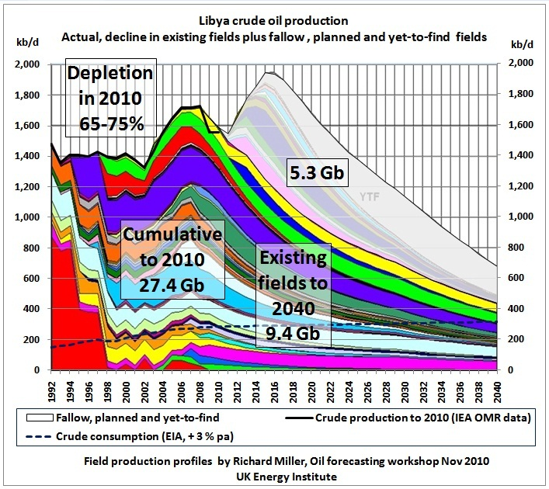
Libya – Production Profiles
Notes:
Production profile of existing fields shows that Gaddafi needed help from international oil companies to stop decline. The condition was to abandon WMD.

Slide 30
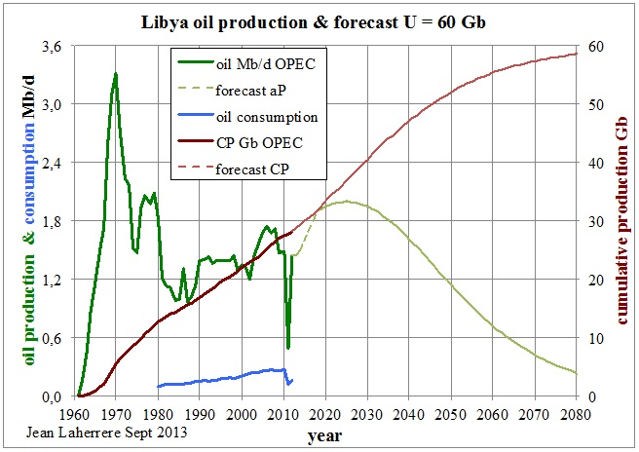
Libya – Oil PRODUCTION & Forecast
Notes:
Jean’s theoretical Hubbert curve peaks in the 2020s

Slide 31
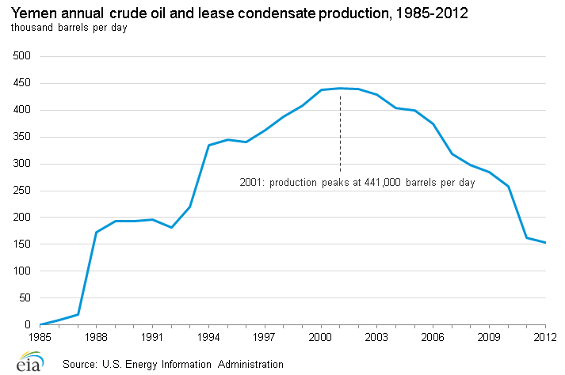
Yemen – C&C
Notes:
Jean’s theoretical Hubbert curve peaks in the 2020s

Slide 32
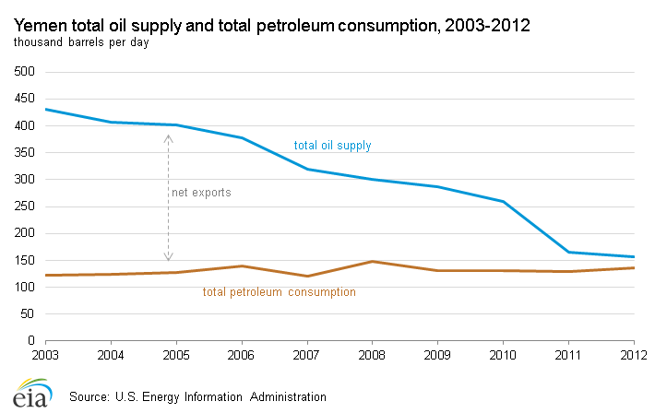
Yemen – Supply & CONSUMPTION

Slide 33
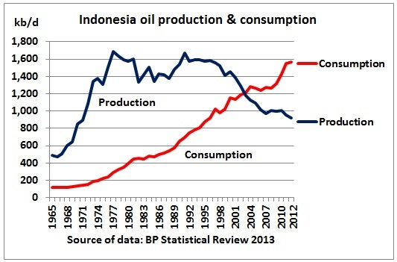
Indonesia – PRODUCTION & CONSUMPTION

Slide 34
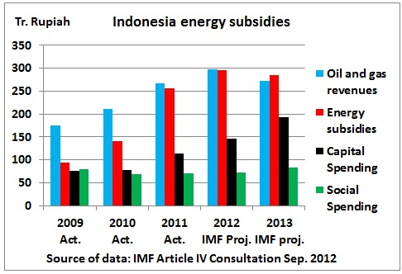
Indonesia – PRODUCTION & CONSUMPTION
Notes:
Post peak oil traffic: more motorbikes than cars
IMF research shows energy subsidies consume oil and gas revenues

Slide 35
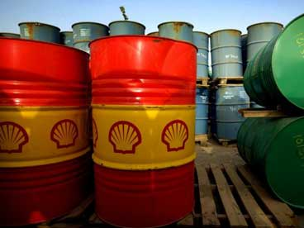
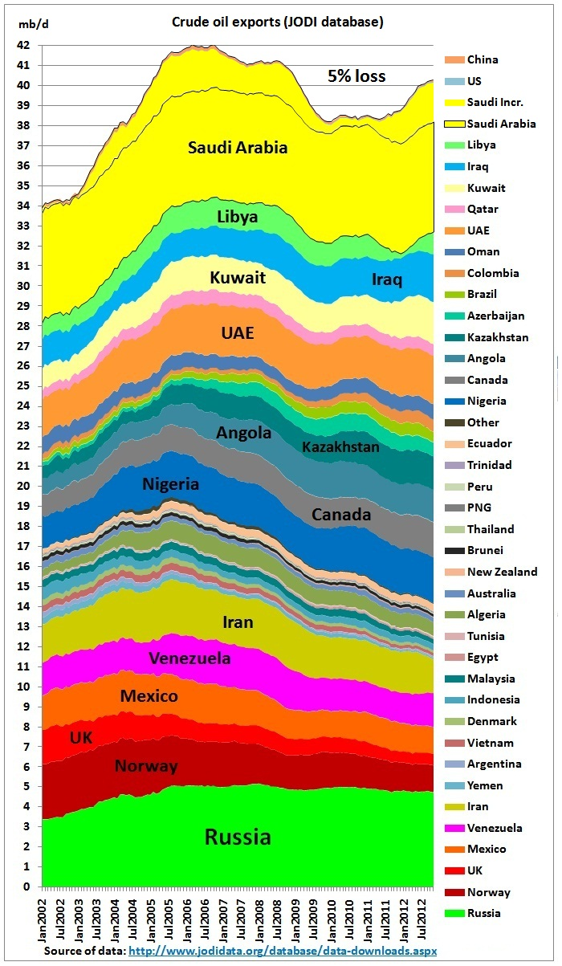
Peak exports

Slide 36
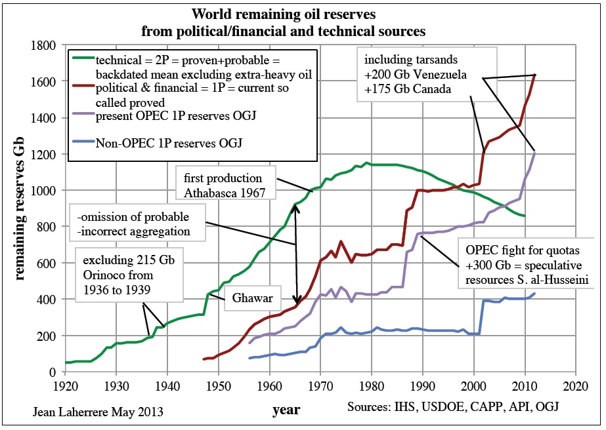
Global remaining reserves
Notes:
Official, political reserves always must show growth. OPEC reports discoveries rather than remaining reserves

Slide 37
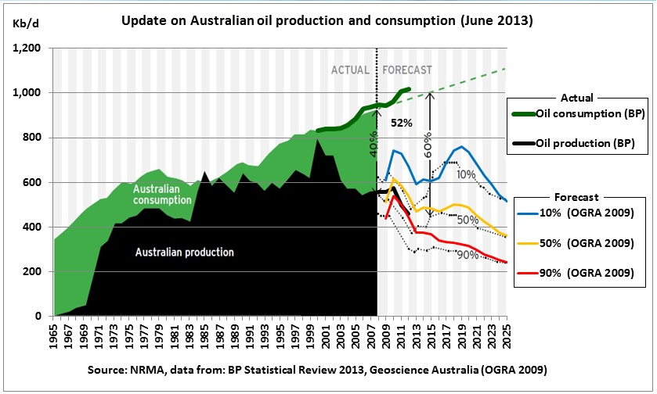
Australian OIL PRODUCTION & CONSUMPTION
Notes:
Growing consumption against 3 production scenarios

Slide 38
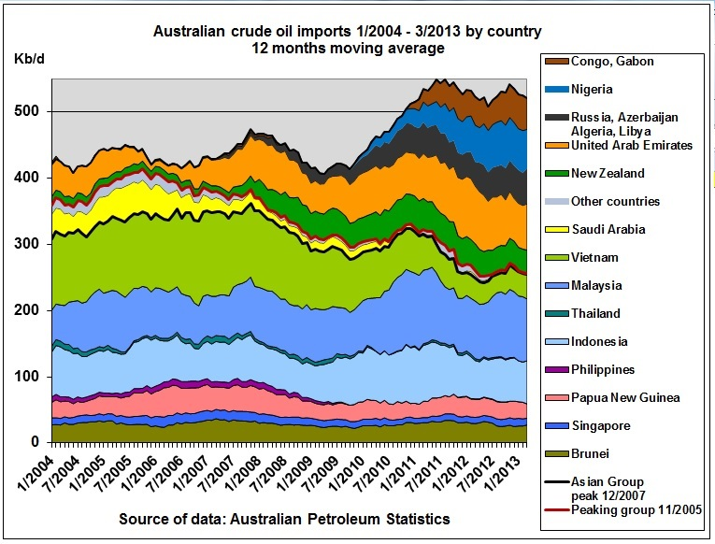
Australian CRUDE OIL IMPORTS
Notes:
Australian refineries were successful to import crude oil from a diverse range of countries after South East Asian neighbours had peaked. Note UAE replaced Saudi Arabia.

Slide 39
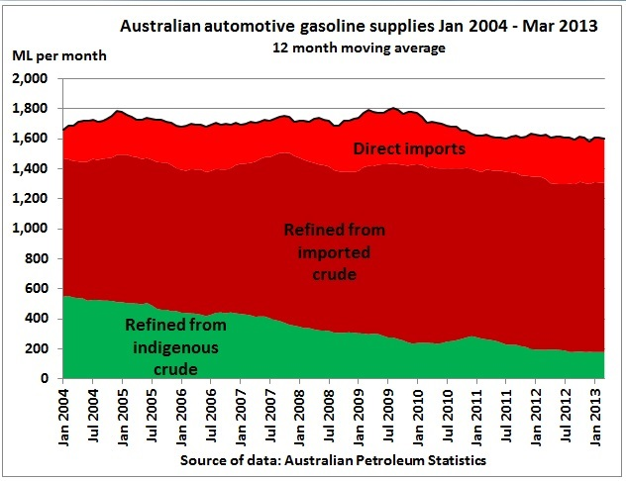
Australian SUPPLIES
We have 3 types of petrol:
Direct Imports
Refined from imported crude
Refined from indigenous crude
Notes:
We have 3 types of petrol: direct imports, refined in Australian refineries from imported crude and indigenous crude

Slide 40
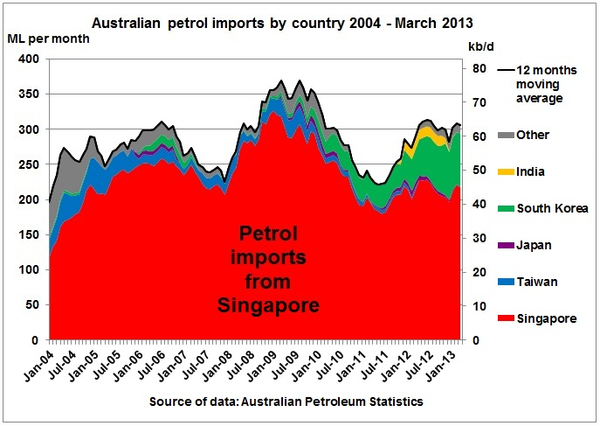
Australian Imports
Notes:
Diesel is also imported from Japan and South Korea

Slide 41
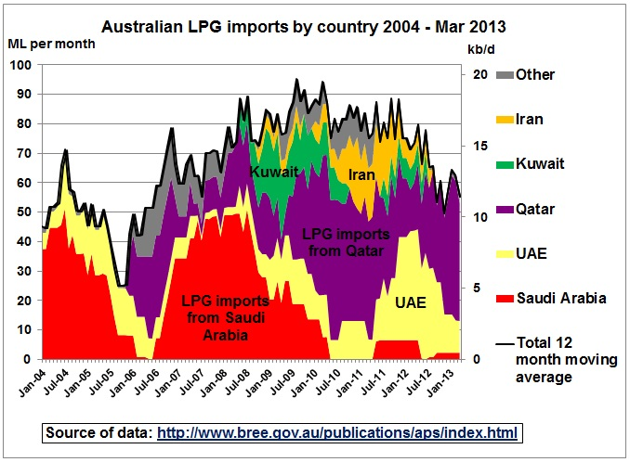
Australian LPG imports
Notes:
Few motorists know that Australia is importing LPG, mainly from UAE and Qatar!

Slide 42
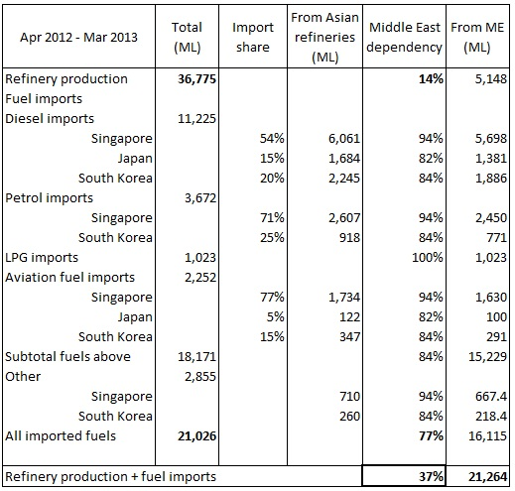
Australian DEPENDENCY ON MIDDLE EAST
37%
Notes:
Table showing Australia is dependent on the ME at 37%

Slide 43
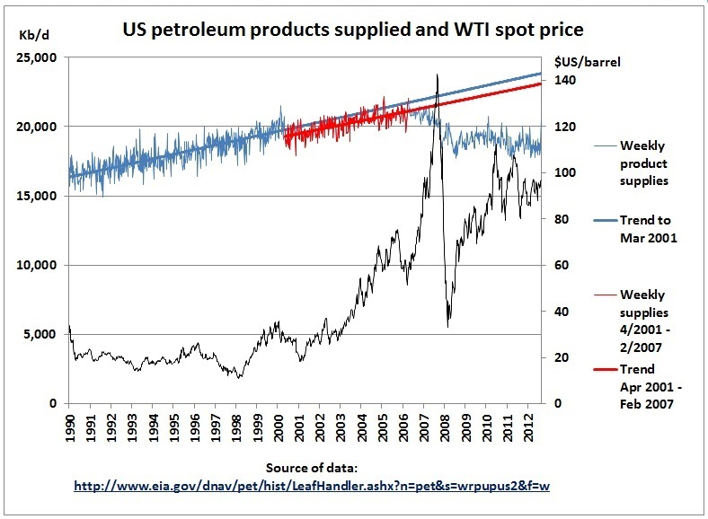
US demand peak
Notes:
Demand curve shifted lower in 2000 then developed a kink in 2006

Slide 44
Oil and recessions

Slide 45
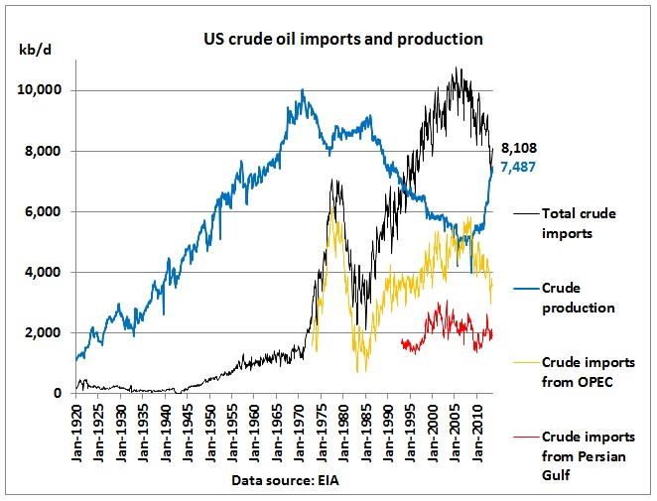
US remains CRUDE oil importer

Slide 46
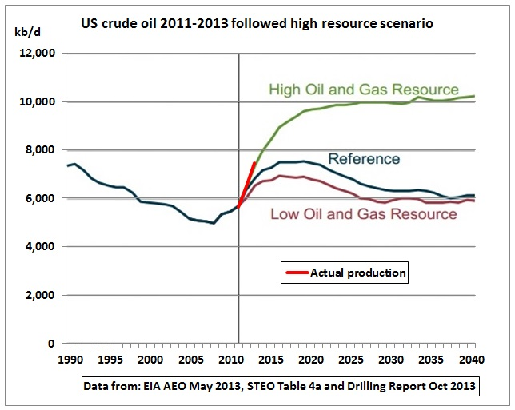
US shale oil will peak
Notes:
Graph from EIA Annual Energy Outlook, May 2013. Actual production so far followed high scenario

Slide 47
Shale oil decline 6% per month
Notes:
The following graph shows the permanent battle in shale oil fields to grow production. As an example in Bakken, decline in old wells has now reached 60 kb/d EVERY MONTH which is 6.3 % of production (red columns), up from 5.5 % 2 years ago.
For November 2013, it is expected that new wells (blue columns) will yield 85 kb/d so the net increase is only 85-60=25 Kb/d. As the monthly decline is increasing with the number of old wells, drilling of new wells has to ever increase. Once this is no longer possible, production will peak.
Data from: AEO 2013 http://www.eia.gov/forecasts/aeo/pdf/0383(2013).pdf
Short term energy outlook http://www.eia.gov/forecasts/steo/report/
and Drilling Report Oct 2013 http://www.eia.gov/todayinenergy/detail.cfm?id=13471

Slide 48
Eagle ford production profile
Notes:
This typical production profile of a shale oil play shows the steep declines experienced in such an oil supply system. If, for argument sake, drilling were to stop (e.g. in another credit crunch) total production would follow these declining lines.

Slide 49
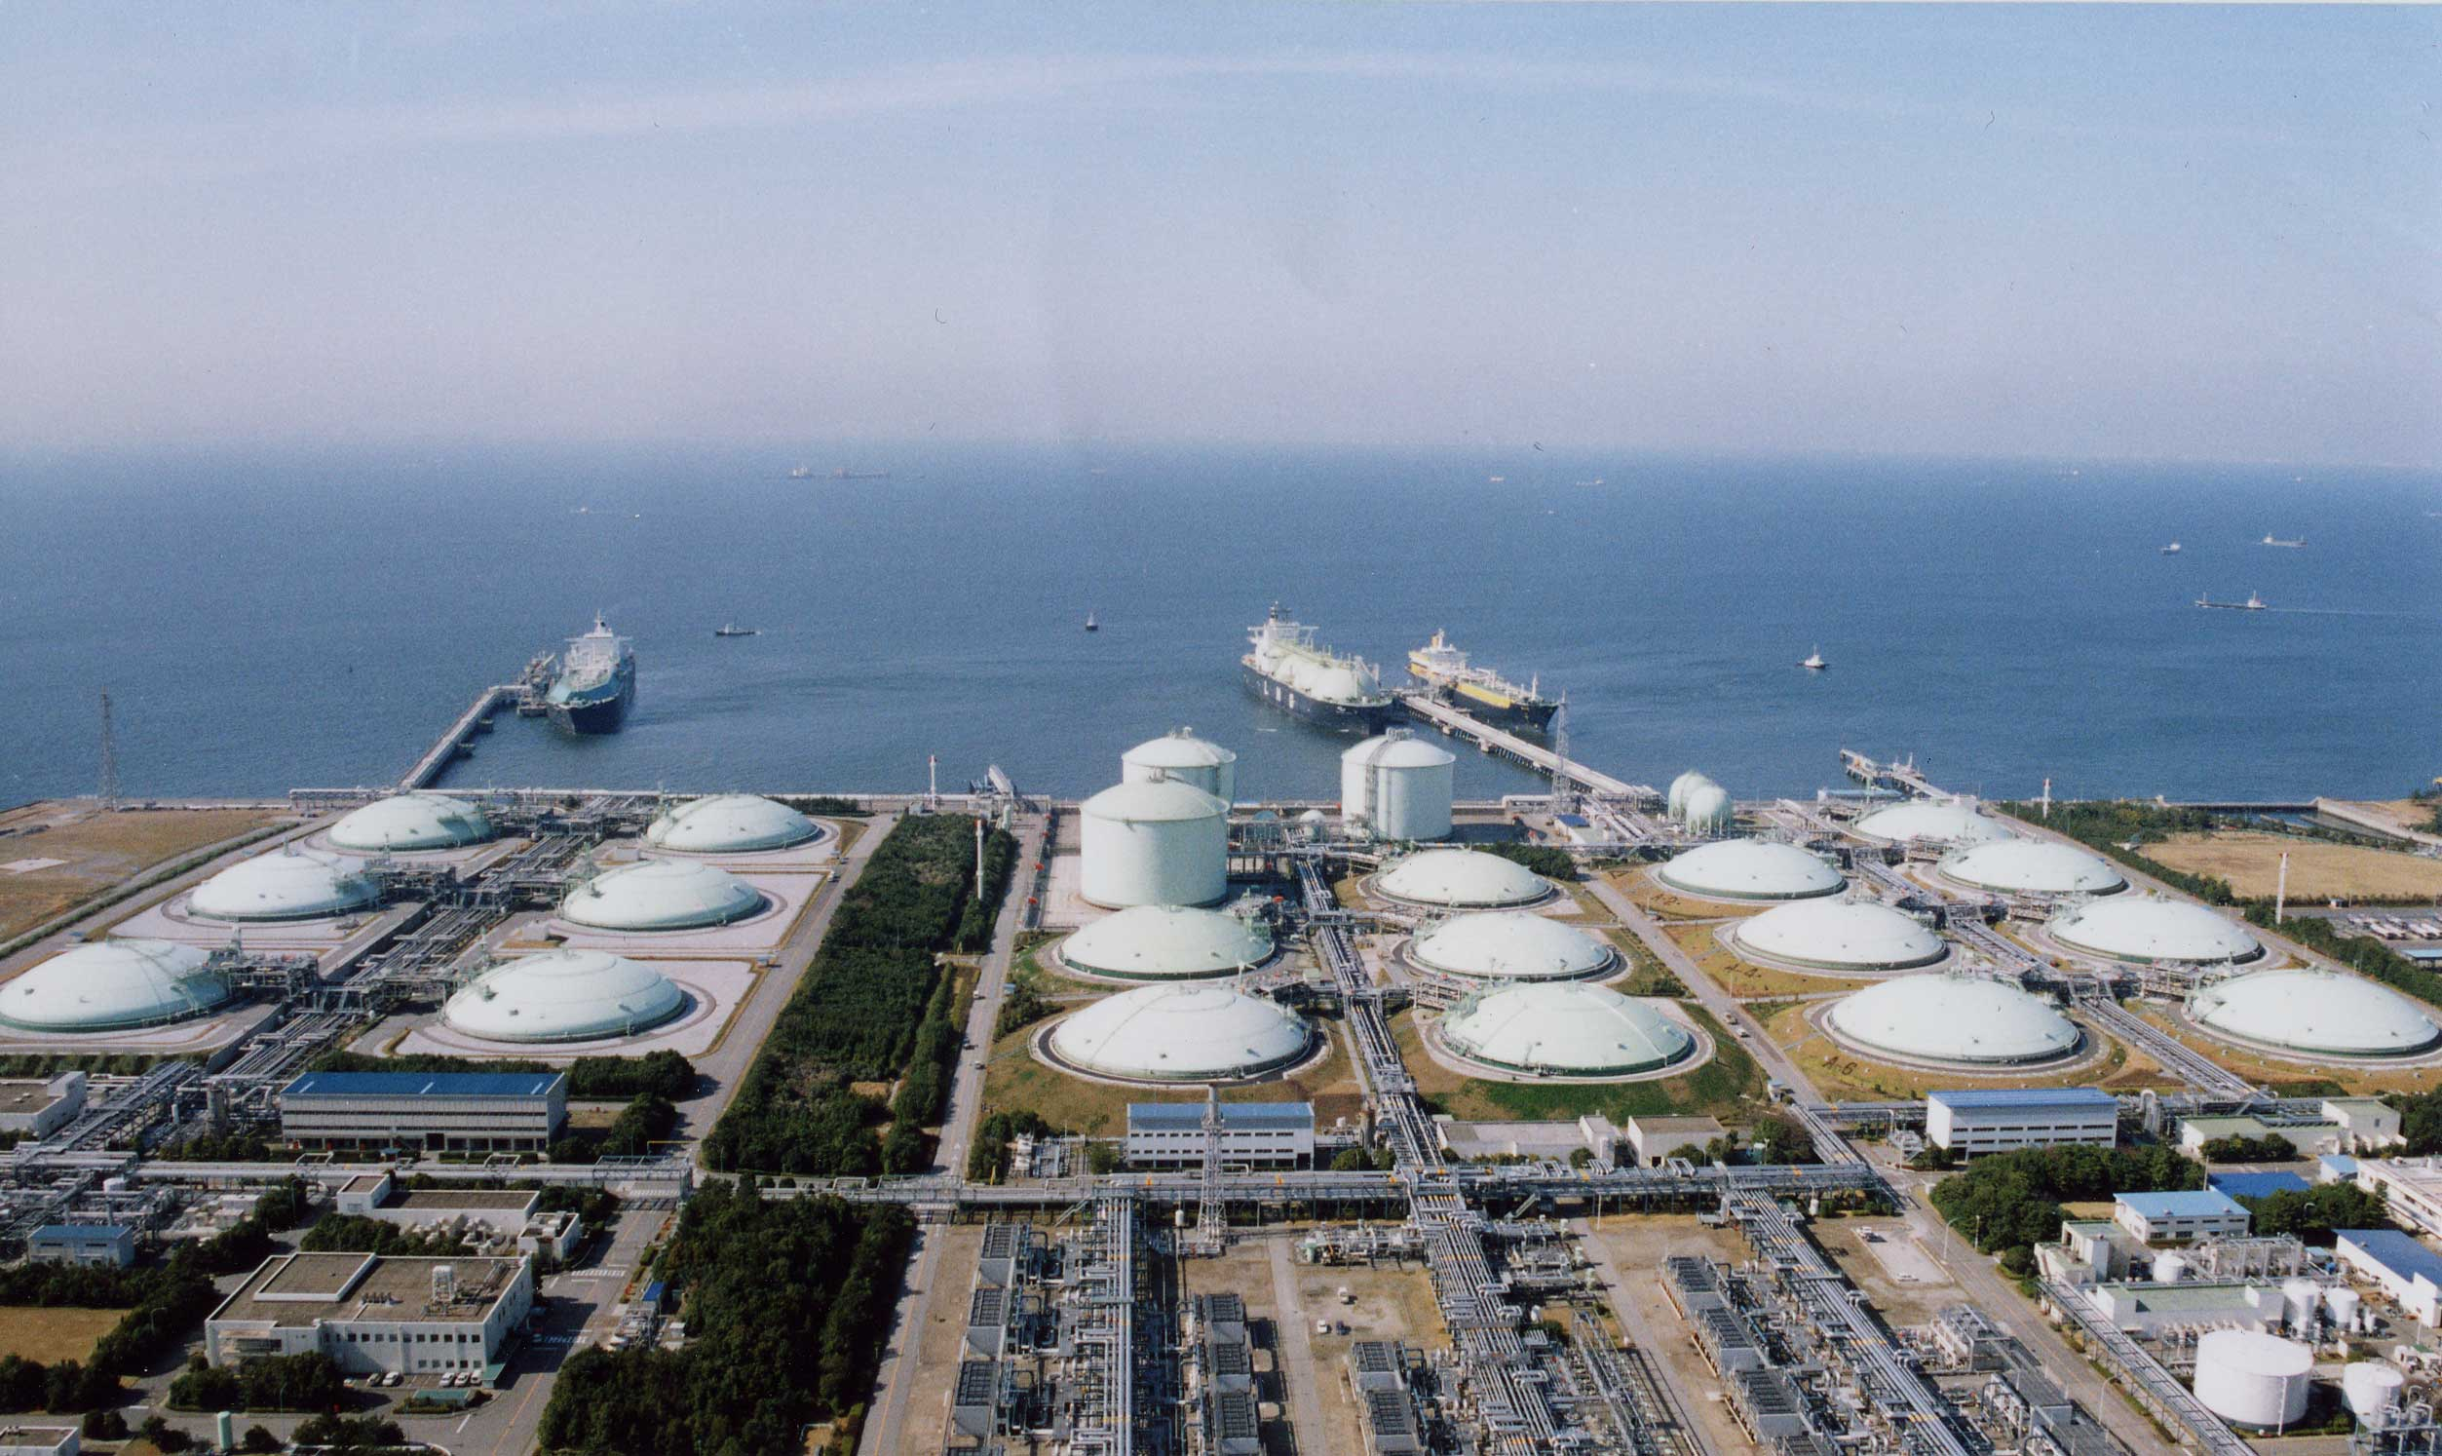
US natural gas – energy revolution?
Notes:
If gas production projection is too optimistic by just 10 % there will be no exports.
If global warming forces US to replace coal with gas, consumption would skyrocket
http://turnkeyoil.com/2012/10/14/eog-resources-goes-all-in-on-oil-unlike-cash-strapped-encana-eog-eca/

Slide 50
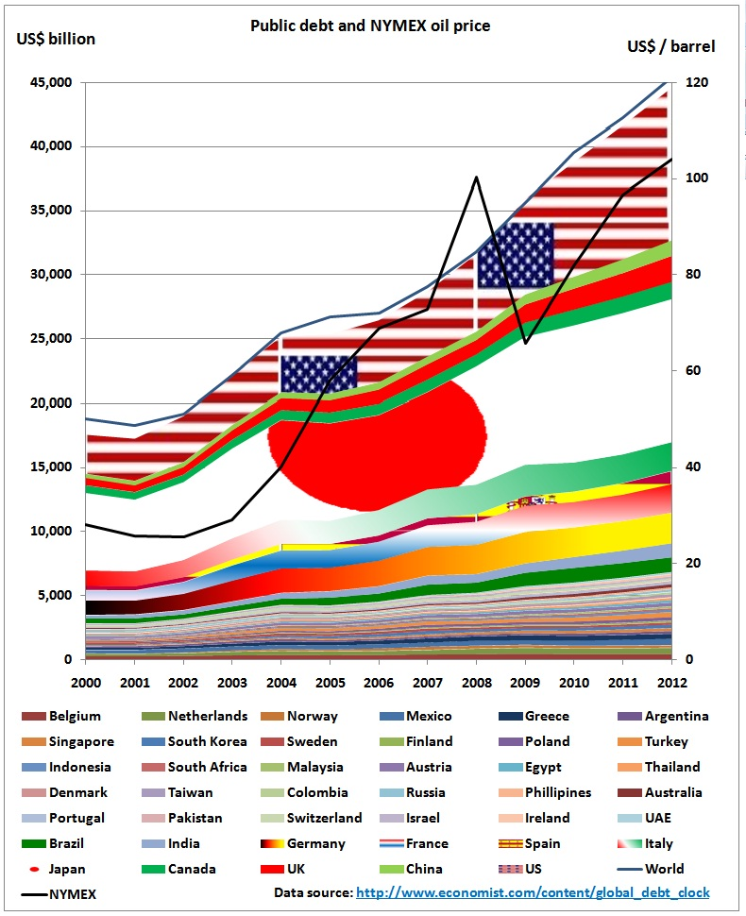
Oil and debt
Notes:
Quantitative Easing (printing money) keeps alive economy which can actually not afford high oil prices. QE also helps to finance drilling cost of US shale oil & gas.
http://www.reportingoilandgas.org/oil-money-not-efficiently-managed-report/

Slide 51
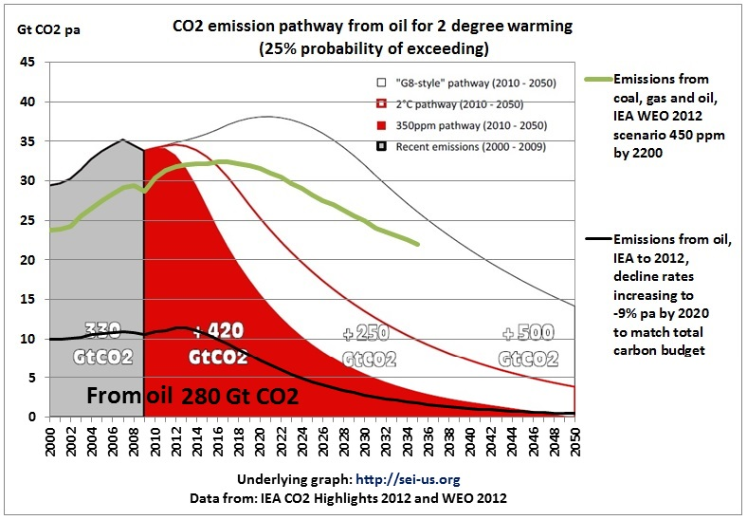
Oil and CO2
Notes:
Half of oil burnable in 2000-2050 to keep us within 2 degrees warming has been used up as we hit 400 ppm

Slide 52
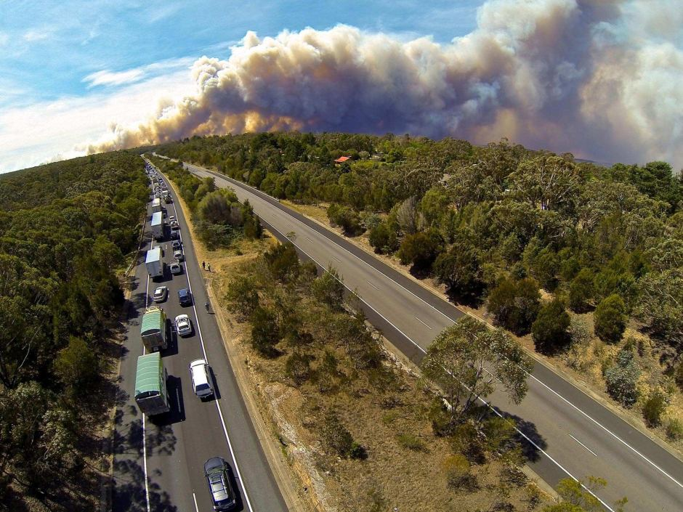
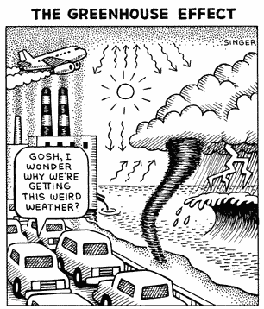
FUTURE OF fossil fuel driven traffic
Notes:
Governments think we can have another 30 years of fossil fuel driven traffic

Slide 53
Golden Age of Gas?
Notes:
Assuming that burning gas produces 50% less CO2 than coal, the growth rate of gas should not be more than twice the decline rate of coal otherwise emissions increase. In this graph this is clearly not the case.

Slide 54
Hansen’s assessment of CO2 emissions

Slide 55
CO₂, CH₄ & Temp
While we’re at it, let’s revisit evolution and gravity
Alan Moir
Notes:
http://carbonsimplicity.files.wordpress.com/2009/12/abbott-moir.jpg

Slide 56
Gas as transport fuel
Notes:
Calculations to replace petrol and diesel
So how much gas would we need to replace all diesel and petrol by compressed natural gas (CNG) or liquefied natural gas (LNG)?
That’s 160 PJ pa for diesel and 215 PJ pa for petrol, in total the equivalent of 1.7 LNG export trains @ 4 mt pa. The problem is of course that Queensland is building these export facilities right now in Gladstone, instead of using and distributing this gas along the East coast as transport fuel

Slide 57
Summary and conclusion
Peak oil projections are difficult
Financial and economic problems have already started in 2005, long before the global peak – whenever that is
Peak oil and global warming put us between a rock and a hard place
Oil and gas must be set aside for agriculture and transport of food
There are complex feed-back loops between oil production, oil prices, oil demand, the economy and debt
Disintegration of Middle East complicates everything
Governments neither prepare for peak oil nor global warming

Slide 58
Who will do peak oil research?
We need a new, young generation of leaders who are oil, energy & climate literate
Are you interested in conducting research on the limitations of oil resources and C02?
Career path starting as advisor in energy industry, government or international organisations
Notes:
http://thegraph.com/2010/12/think-tank-for-teapartiers/

